Slide 1
Topic List
Programming Languages:
Family Trees.
Typing Spectrum.

Slide 2
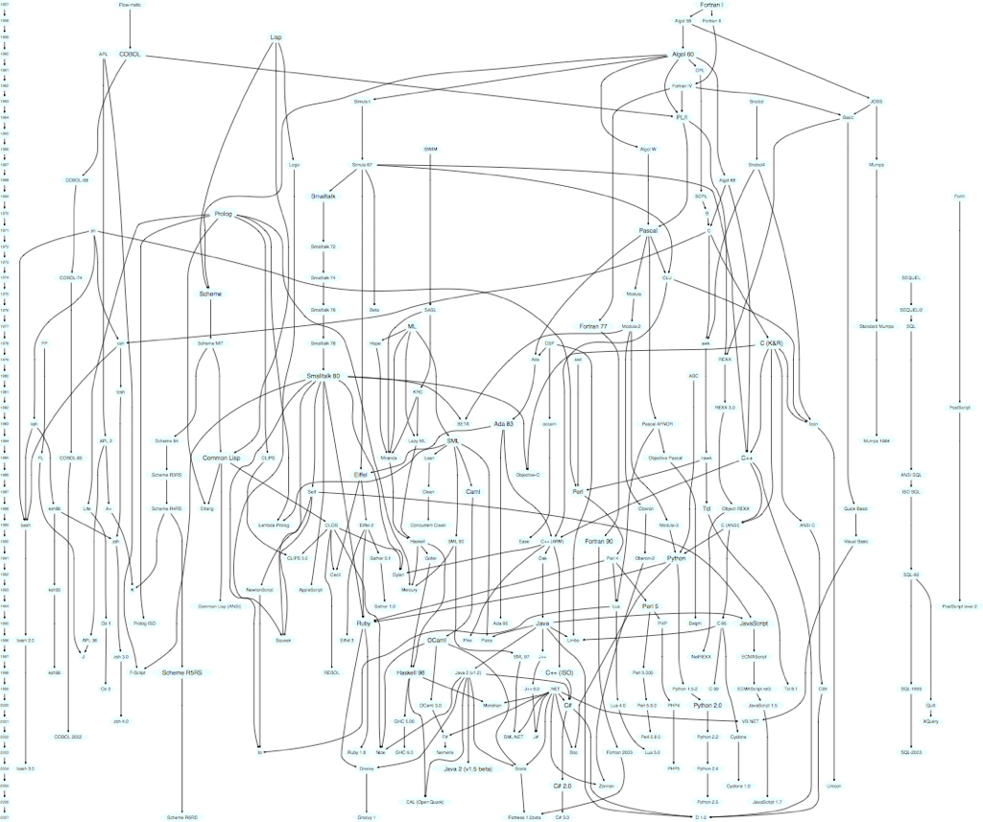
Family Tree

Slide 3
Family Tree
“Lisp is the bar other languages are measured against.”
“Knowing Lisp demonstrates developer enlightenment.”
Lisp - designed late 1950s - departure from existing languages (e.g. Fortran).
https://hase85.wordpress.com/2013/01/15/best-of-lisp-quotes/

Slide 4
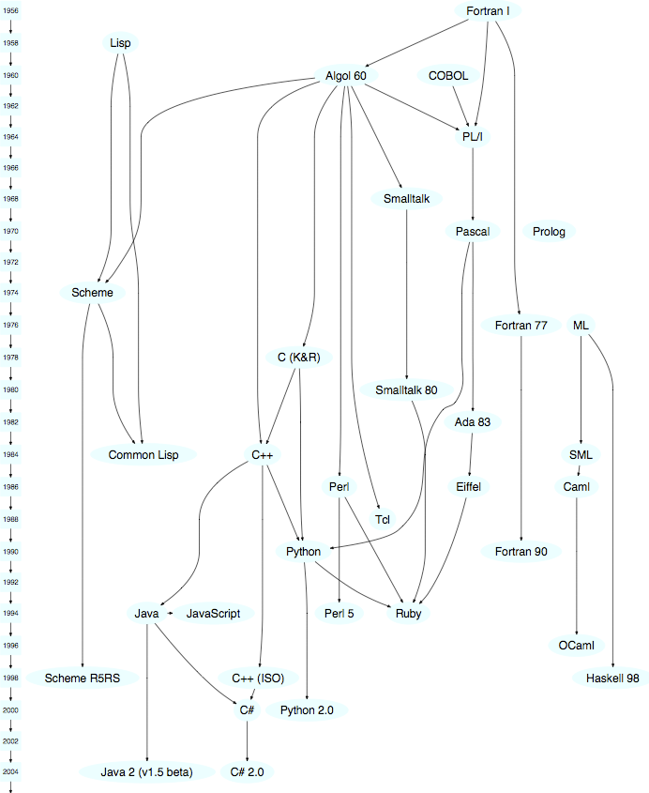
Family Tree

Slide 5
Family Tree
Objective C – borrows Smalltalk concepts & syntax.
Java – borrows Smalltalk bytecode and garbage collection.
Smalltalk - pure OO language → everything is an object!
Ruby – pure OO model almost identical to Smalltalk.
https://www.cs.cmu.edu/~charlie/courses/15-214/2014-fall/slides/25-history-oo.pdf

Slide 6
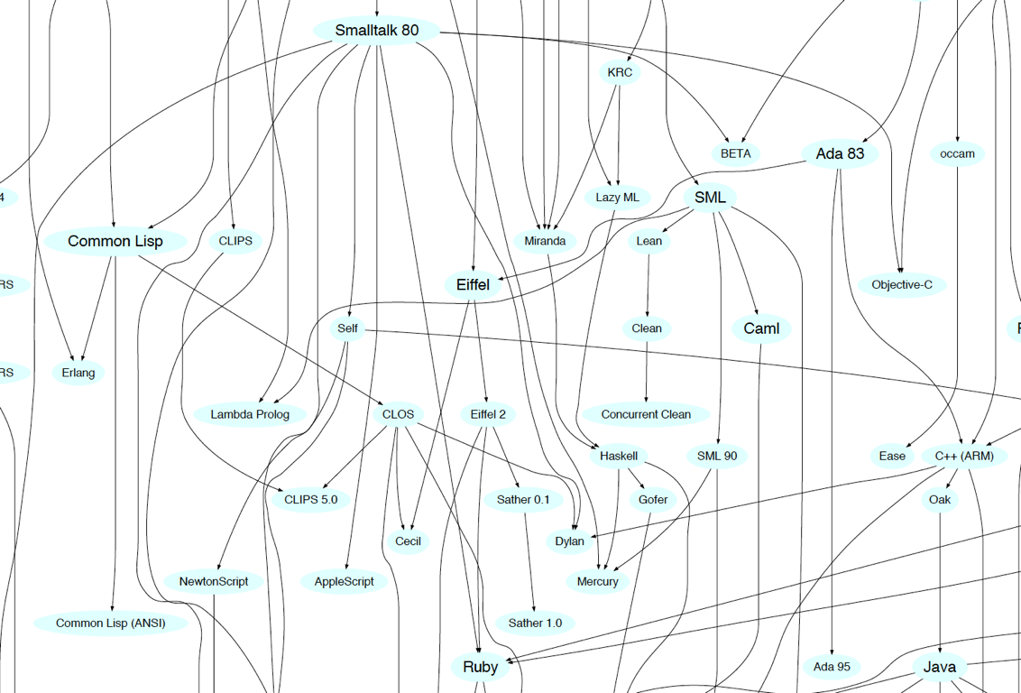
Smalltalk Cluster
Family Tree

Slide 7
Smalltalk
Mainstream OO Languages

Slide 8
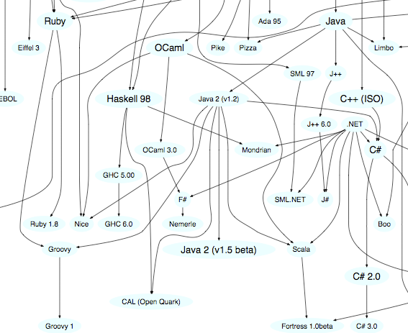
Ruby, Groovy, Java, Scala Cluster
Family Tree

Slide 9
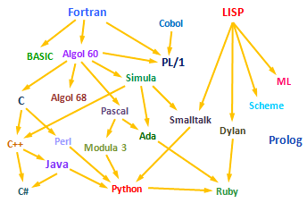
Family Tree
Objective-C
Scala
Groovy
Swift
Kotlin
Go

Slide 10
Typing The concept of applying a “type” to a variable

Slide 11
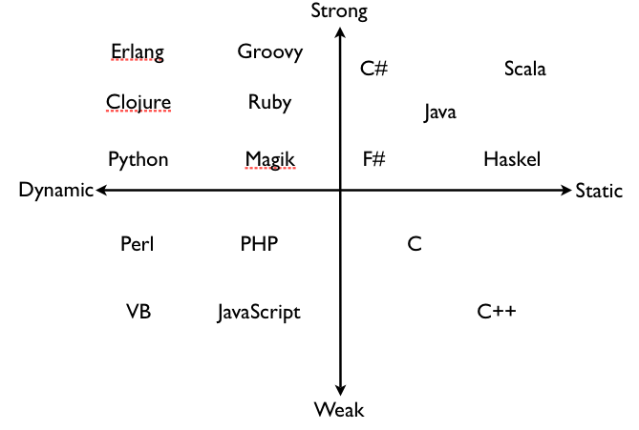
Typing Spectrum
Languages are often classified based on their approach to typing…

Slide 12
Defining Typing Terms...
“There is widespread confusion or disagreement about the meanings of the words
static, dynamic, strong and weak
when used to describe the type systems of programming languages”
https://pythonconquerstheuniverse.wordpress.com/2009/10/03/static-vs-dynamic-typing-of-programming-languages/

Slide 13
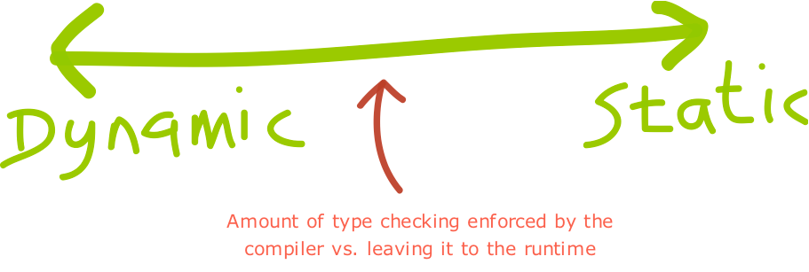

Slide 15
Dynamic Typing
“Variables’ type declarations
are not mandatory
and they will be
generated/inferred on the fly,
by their first use.”
http://blogs.agilefaqs.com/2011/07/11/dynamic-typing-is-not-weak-typing/

Slide 16
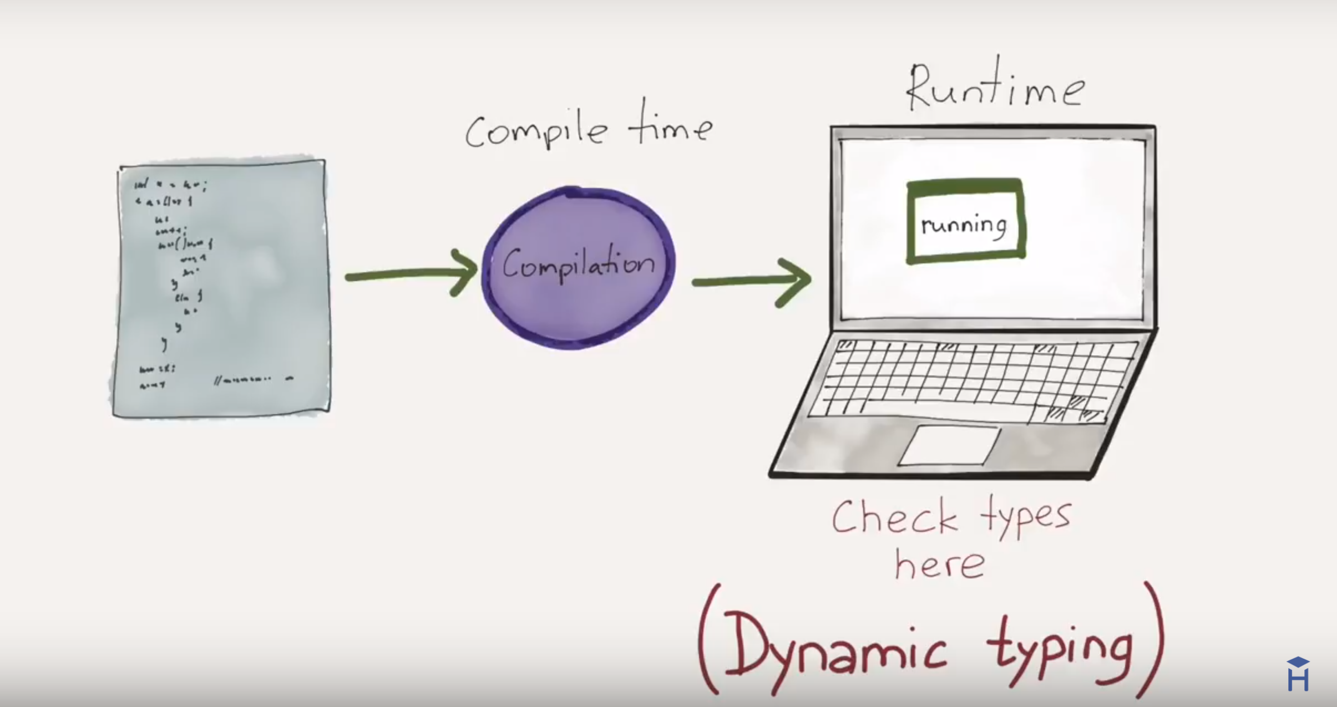
https://www.youtube.com/watch?v=C5fr0LZLMAs

Slide 17
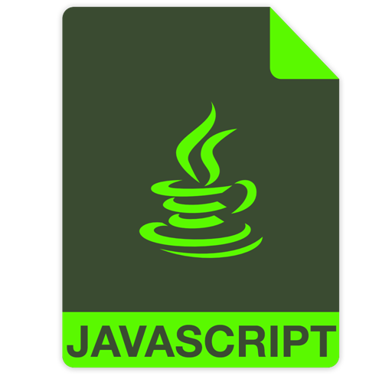
Dynamic Typing – Example
var greeting = ; //undefined
var someRandomInteger = 100;
var aDoubleVariable = 2.2;
greeting = "Hello!";
The JavaScript engine will choose a type that it feels best describes the data that’s contained inside of your variable → assign datatype behind the scenes.
A type is NOT assigned to the variables.
https://howtoprogramwithjava.com/dynamic-typing-vs-static-typing/

Slide 18
Static Typing
“Variable declarations are mandatory
before usage, else
results in a compile-time error"
http://blogs.agilefaqs.com/2011/07/11/dynamic-typing-is-not-weak-typing/

Slide 19
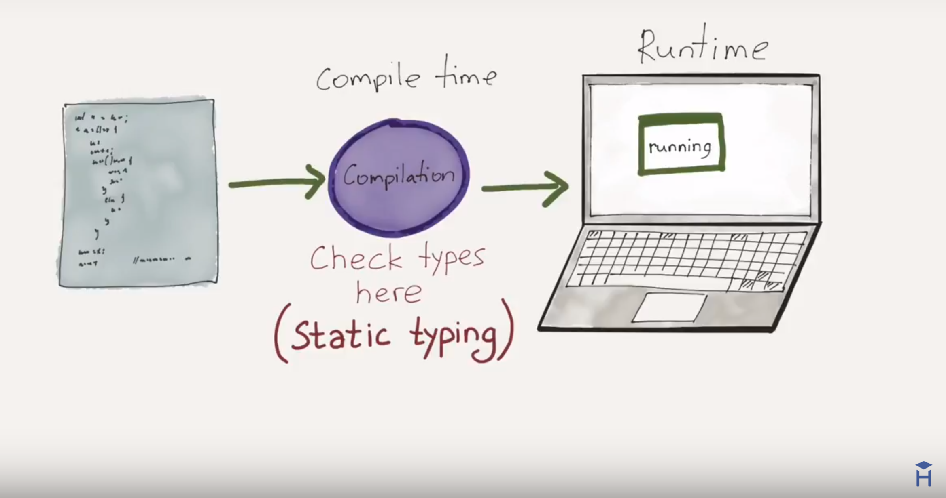
https://www.youtube.com/watch?v=C5fr0LZLMAs

Slide 20
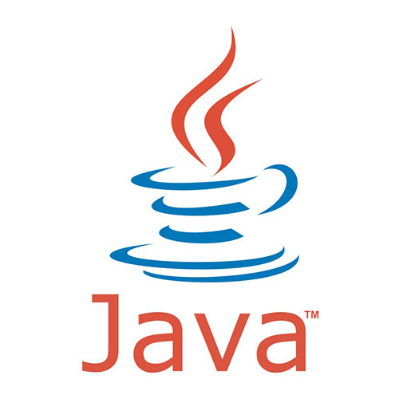
Static Typing – Example
String greeting = "Hello!";
int someRandomInteger = 100;
double aDoubleVariable = 2.2;
In Java, if we don’t assign a type, we get a compiler error → Java is statically typed.
Types determine the operations we can perform on the variables.
A type is assigned to each variable.
https://howtoprogramwithjava.com/dynamic-typing-vs-static-typing/

Slide 21
http://blogs.agilefaqs.com/2011/07/11/dynamic-typing-is-not-weak-typing/

Slide 22
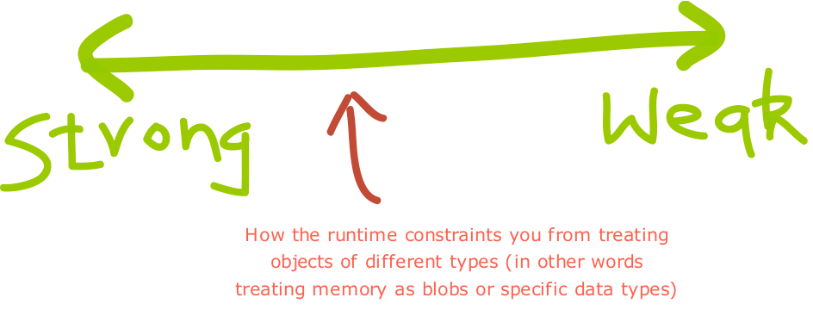

Slide 24
Strong Typing
“Once a variable is
declared as a specific data type,
it will be bound to that
particular data type.
You can explicitly cast the data type though.”
http://blogs.agilefaqs.com/2011/07/11/dynamic-typing-is-not-weak-typing/

Slide 25
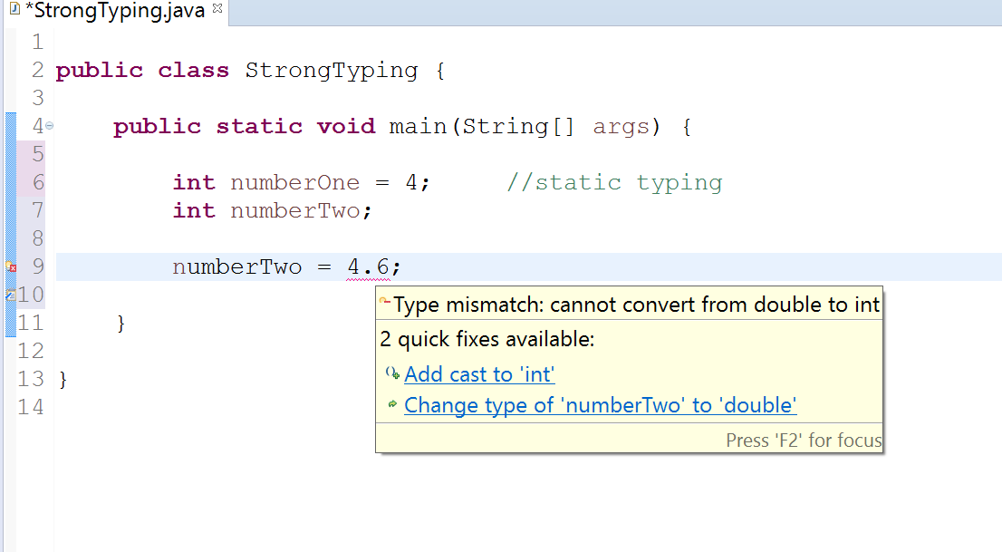
Strong Typing – Example 1

Slide 26
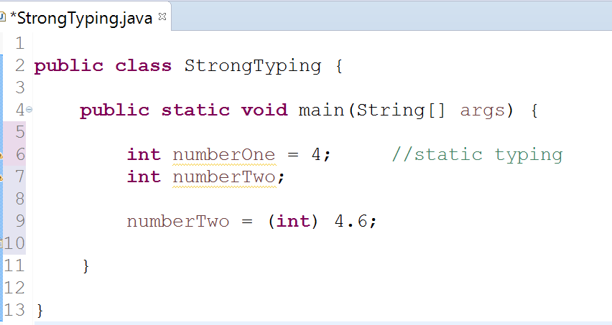
Strong Typing – Example 1 (fix with casting)
Casting resolves the type mismatch error

Slide 27
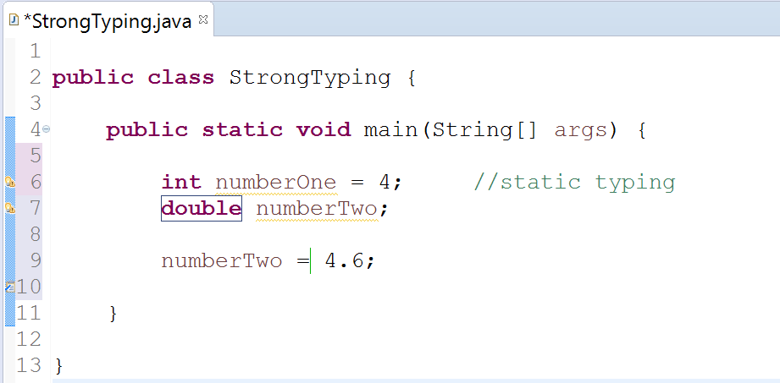
Strong Typing – Example 1 (fix with type)
Changing type to double from int.

Slide 28
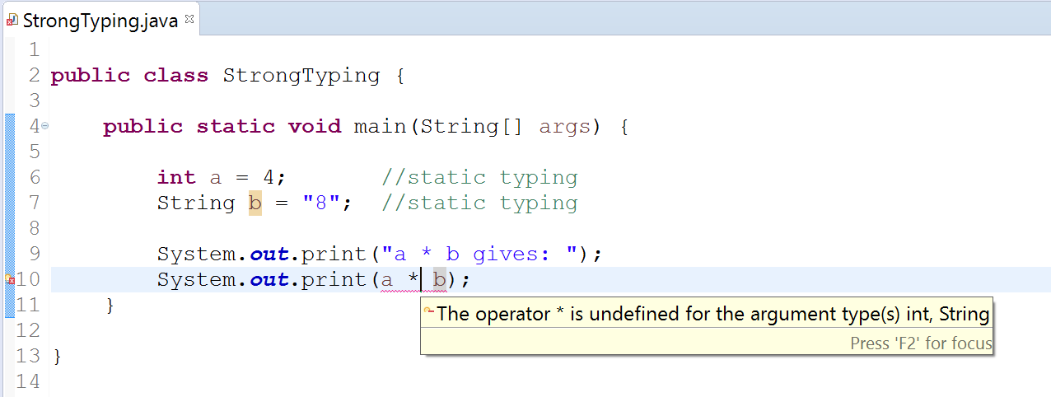
Strong Typing – Example 2

Slide 29
Weak Typing
“Variables are not of a specific data type.
However it doesn’t mean that variables are not “bound” to a specific data type.
In weakly typed languages, once a block of memory is associated with an object it can be reinterpreted as a different type of object.”
http://blogs.agilefaqs.com/2011/07/11/dynamic-typing-is-not-weak-typing/

Slide 30
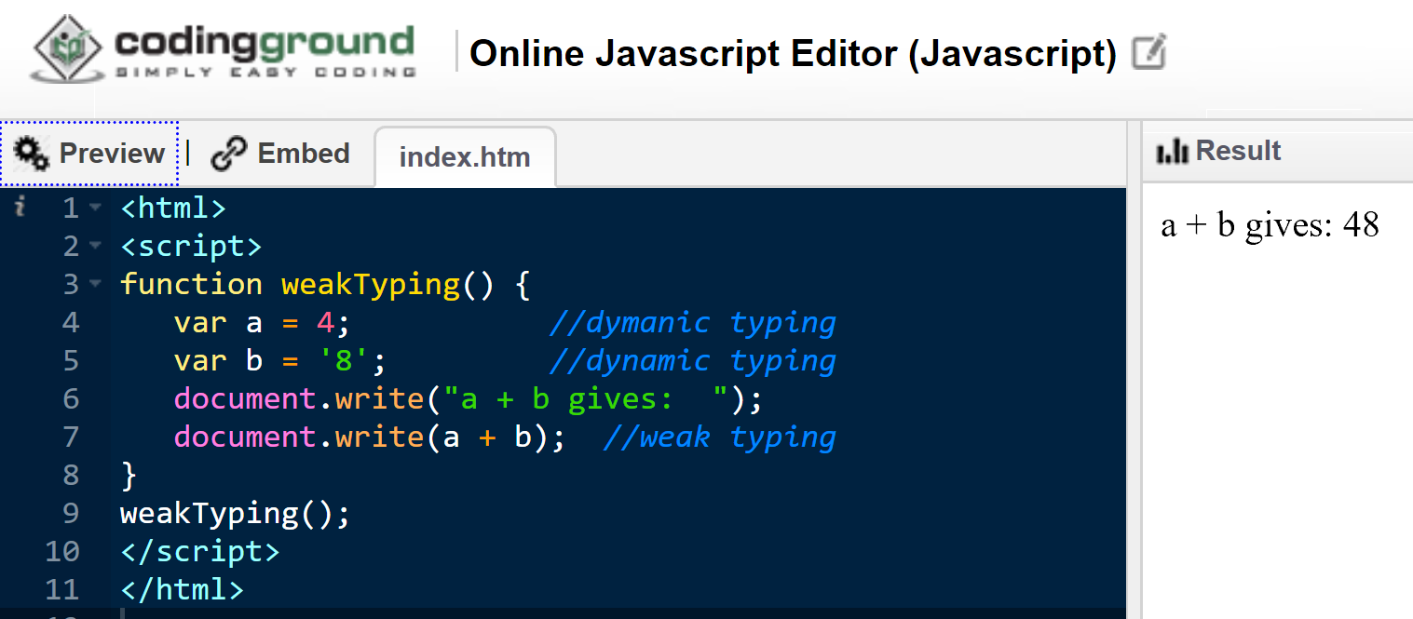
Weak Typing – Example 1
Notes:
<html><script>function weakTyping() { var a = 4; //static typing var b = '8'; //static typing document.write("a + b gives: "); document.write(a + b); //weak typing}weakTyping();</script></html>

Slide 31
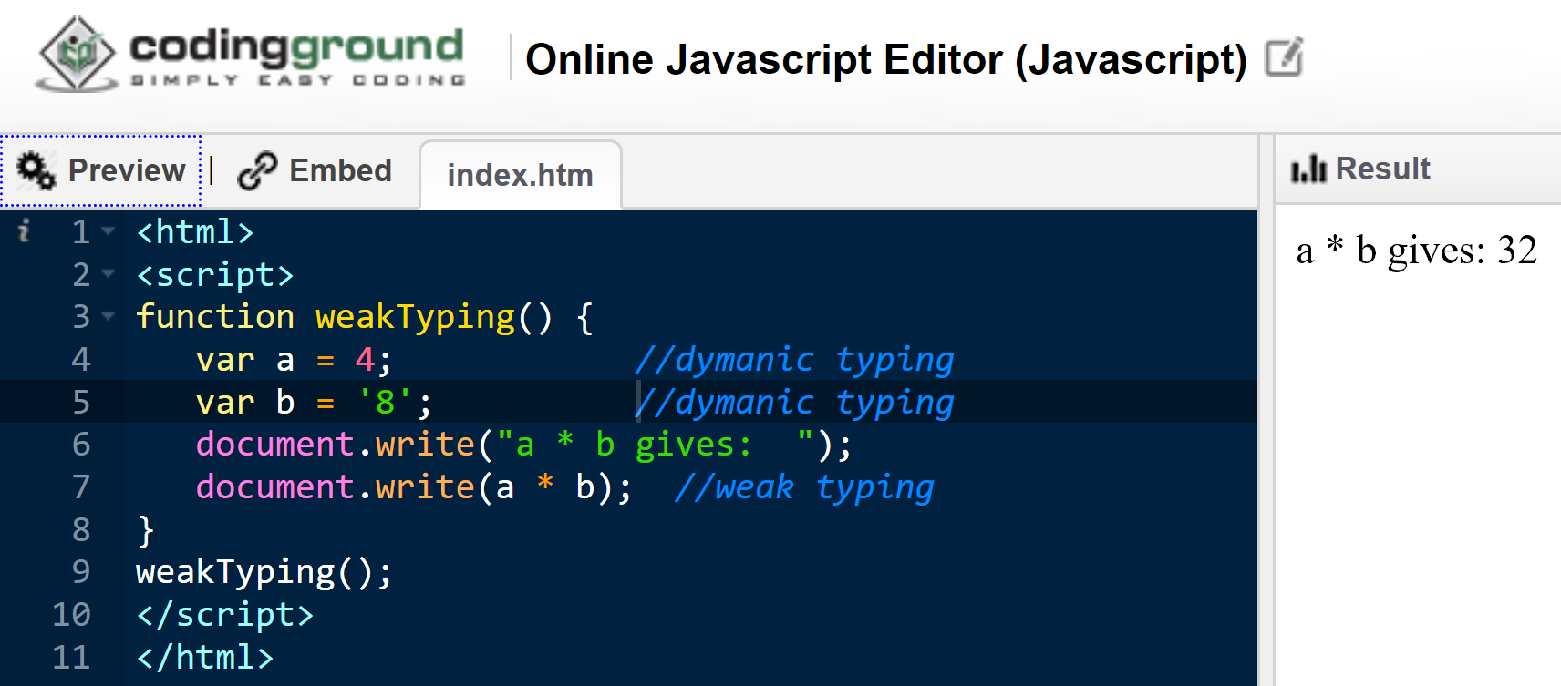
Weak Typing – Example 2

Slide 32
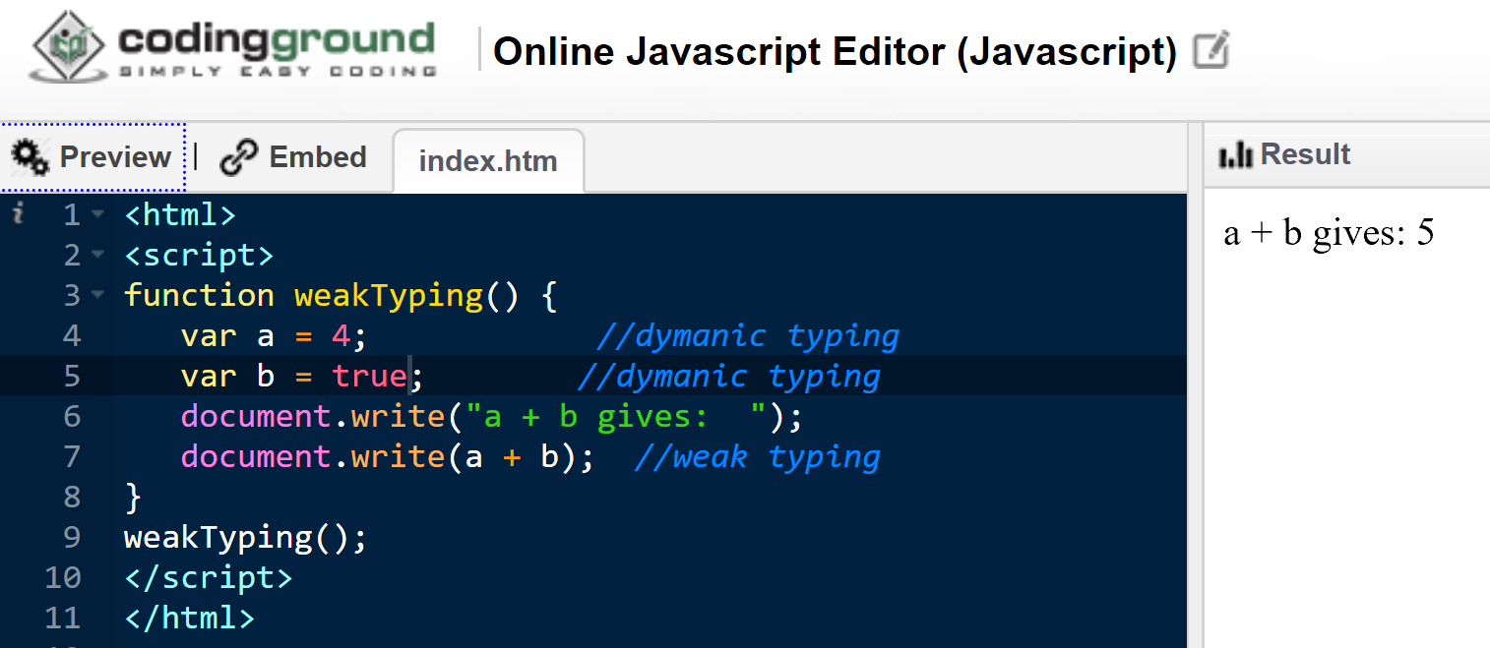
Weak Typing – Example 3

Slide 33
http://blogs.agilefaqs.com/2011/07/11/dynamic-typing-is-not-weak-typing/

Slide 34
Typing Spectrum
Continuum rather than an absolute measure; e.g. SmallTalk is more strongly typed compared to Python which is more strongly typed than JavaScript.
http://blogs.agilefaqs.com/2011/07/11/dynamic-typing-is-not-weak-typing/

